Slide 1
System Panic
Presenters
Layla Hoey
Lee St. Louis

Slide 2
Agenda
Character Art Updates
Enemy Art Updates
Intersection Updates
Player Inventory
Loadout Selection
Attribute Upgrade System
Up Next

Slide 3
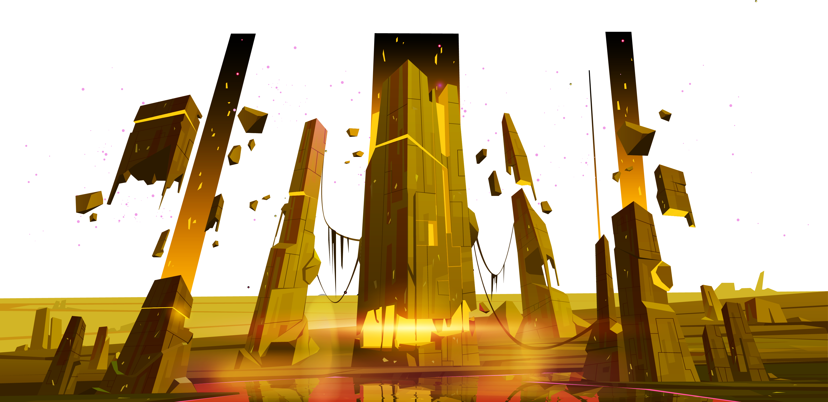
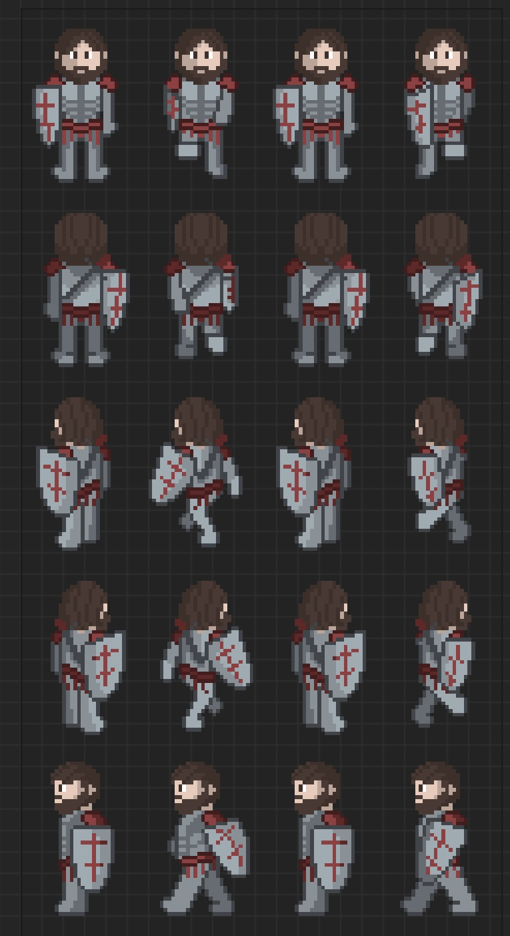
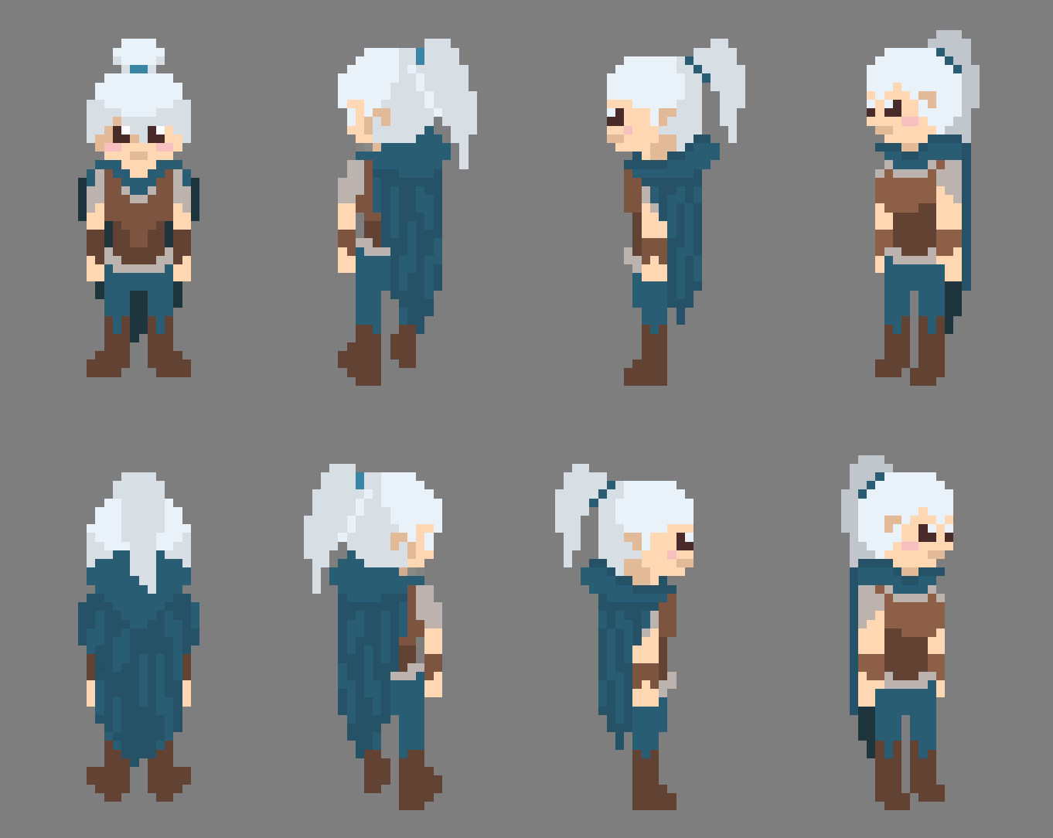
Art – Player
Character Class - Tank
Updated Concepts
More natural shading
Character Class - Rogue

Slide 4
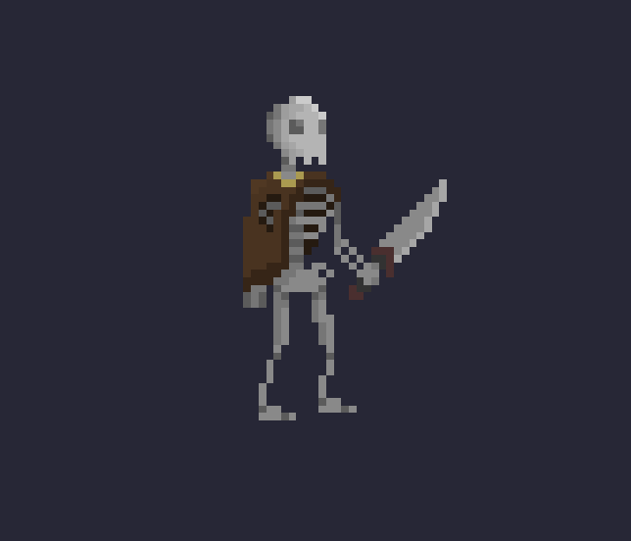
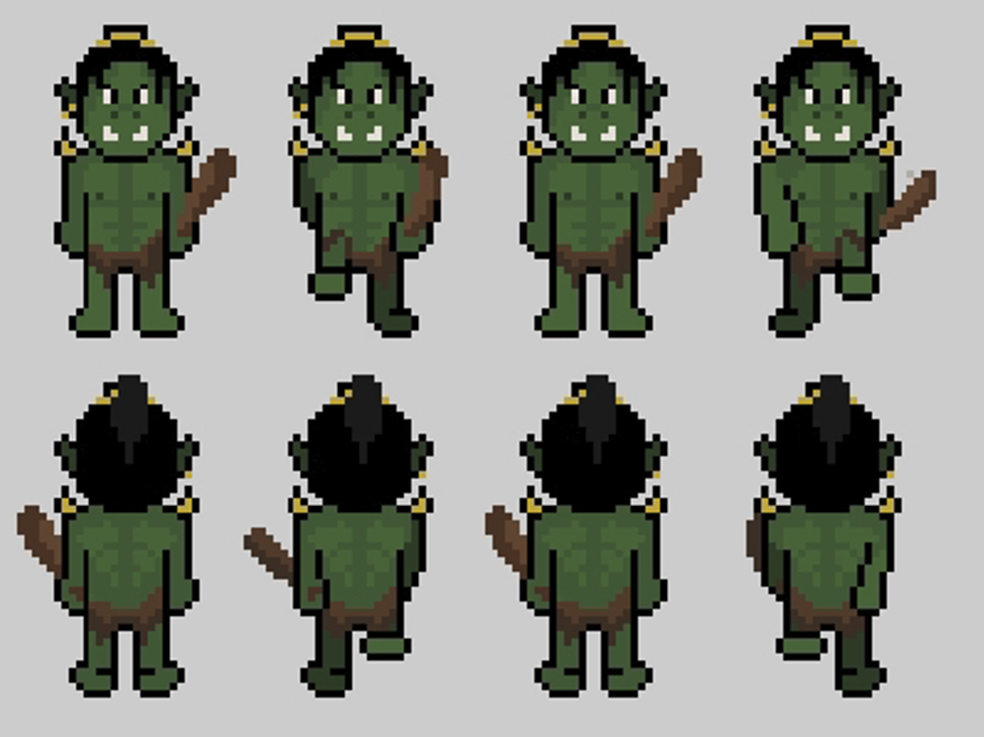
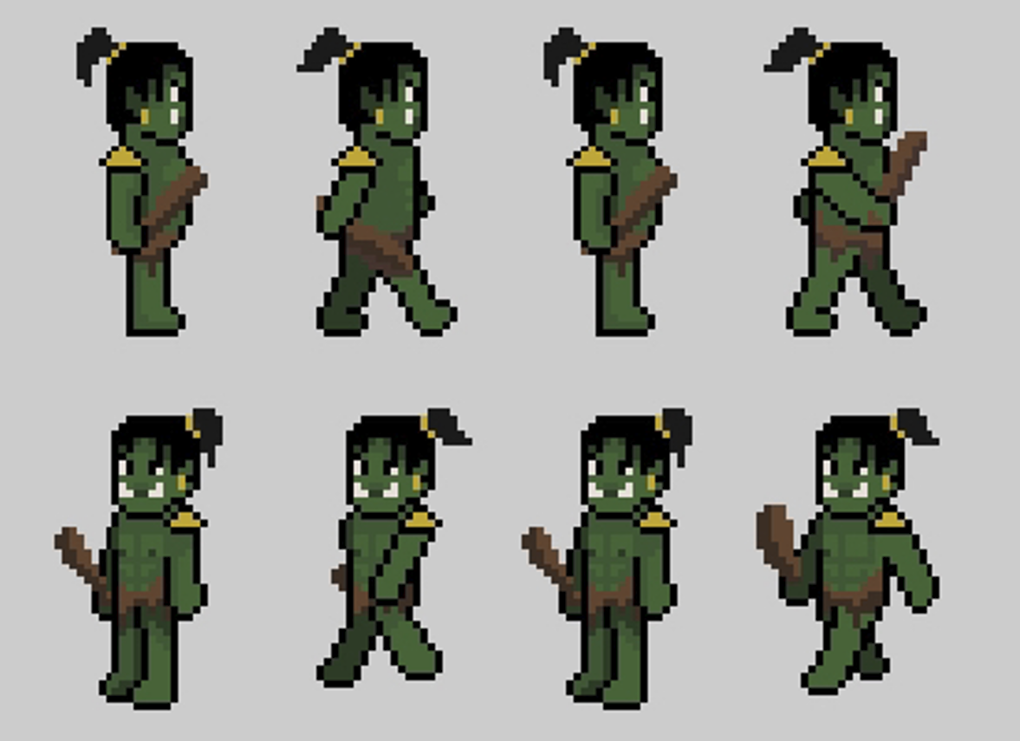
Art - Enemies
Orc
Skeleton

Slide 5
Intersection Updates
New Intersections made last week

Slide 6
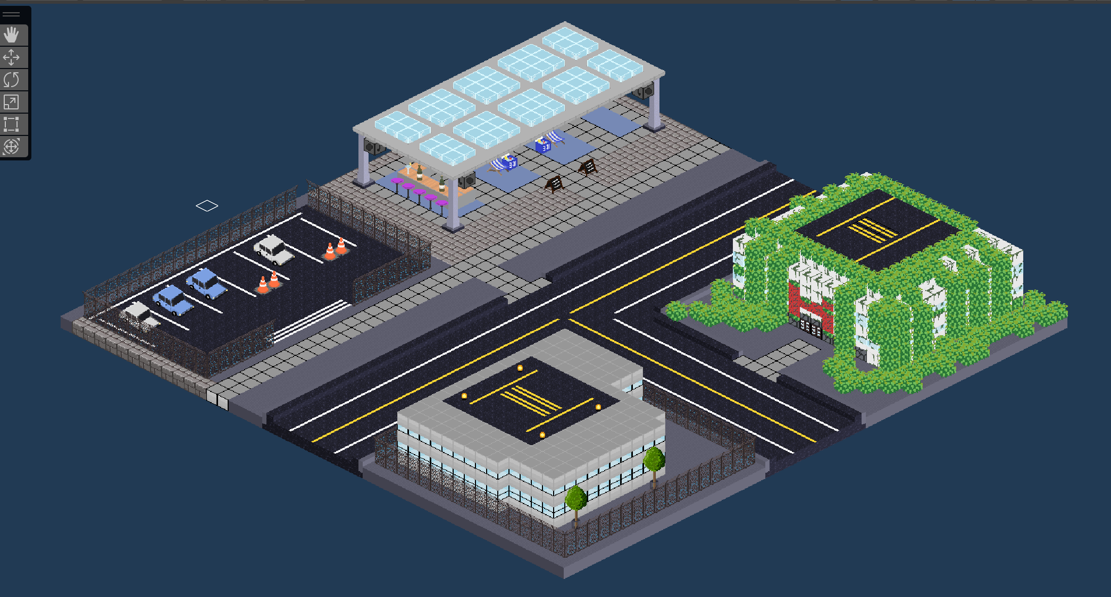
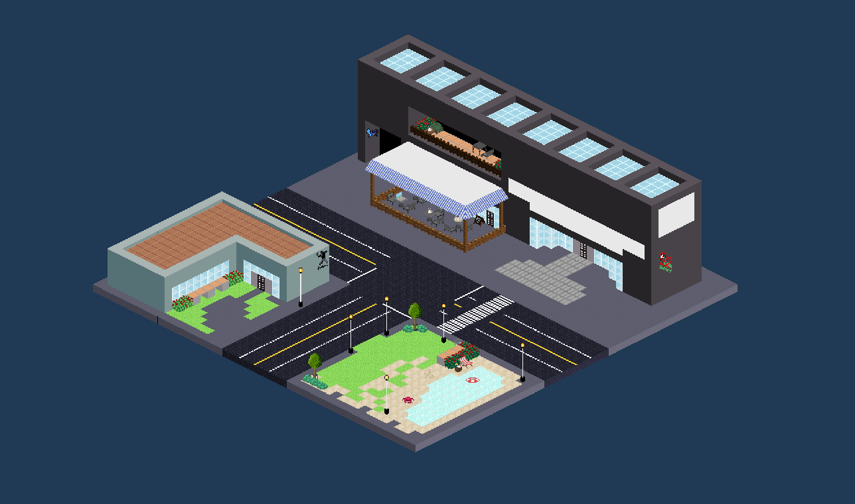
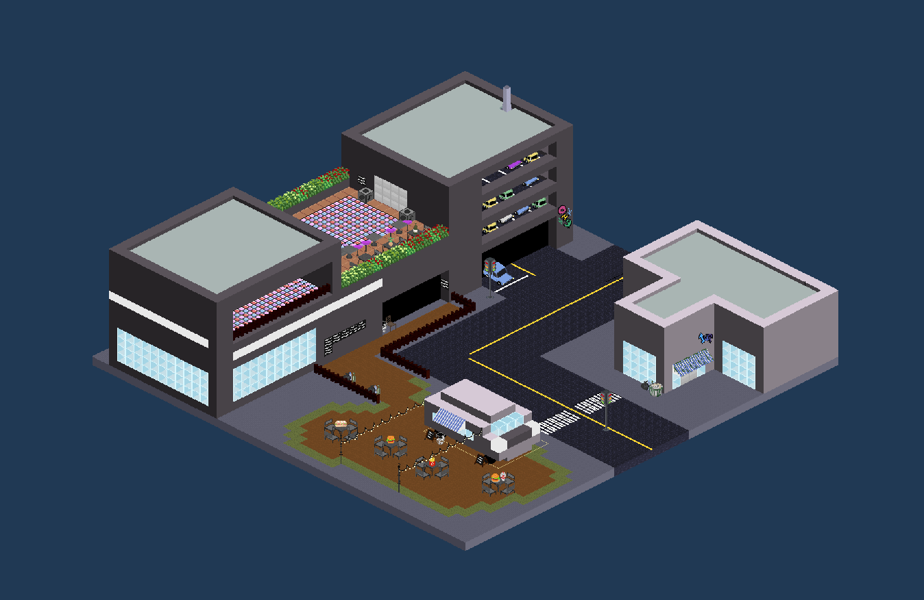
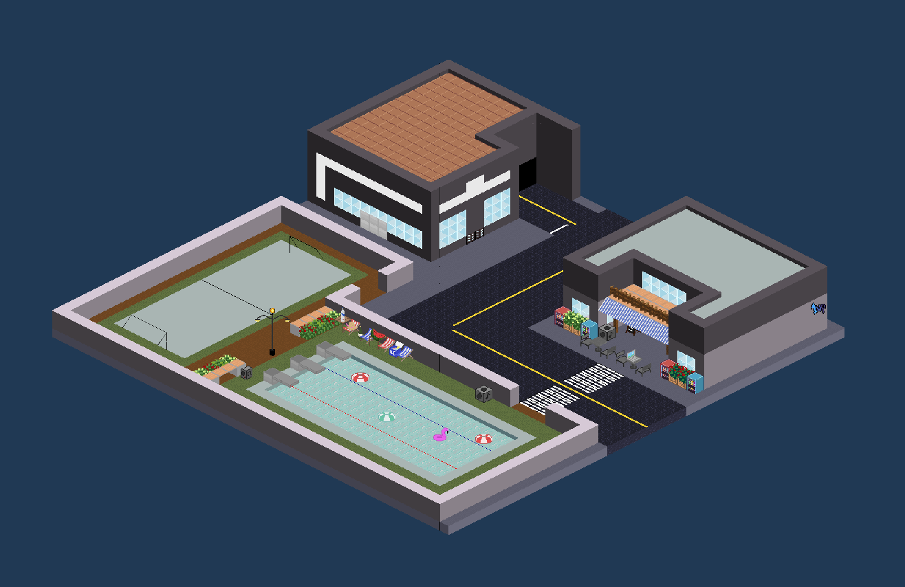

Slide 7
Dungeon Updates
New Dungeons made last week

Slide 8
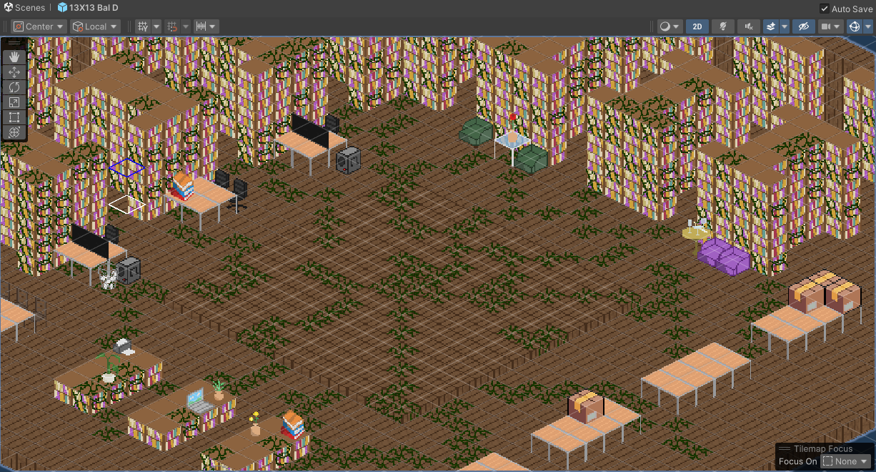
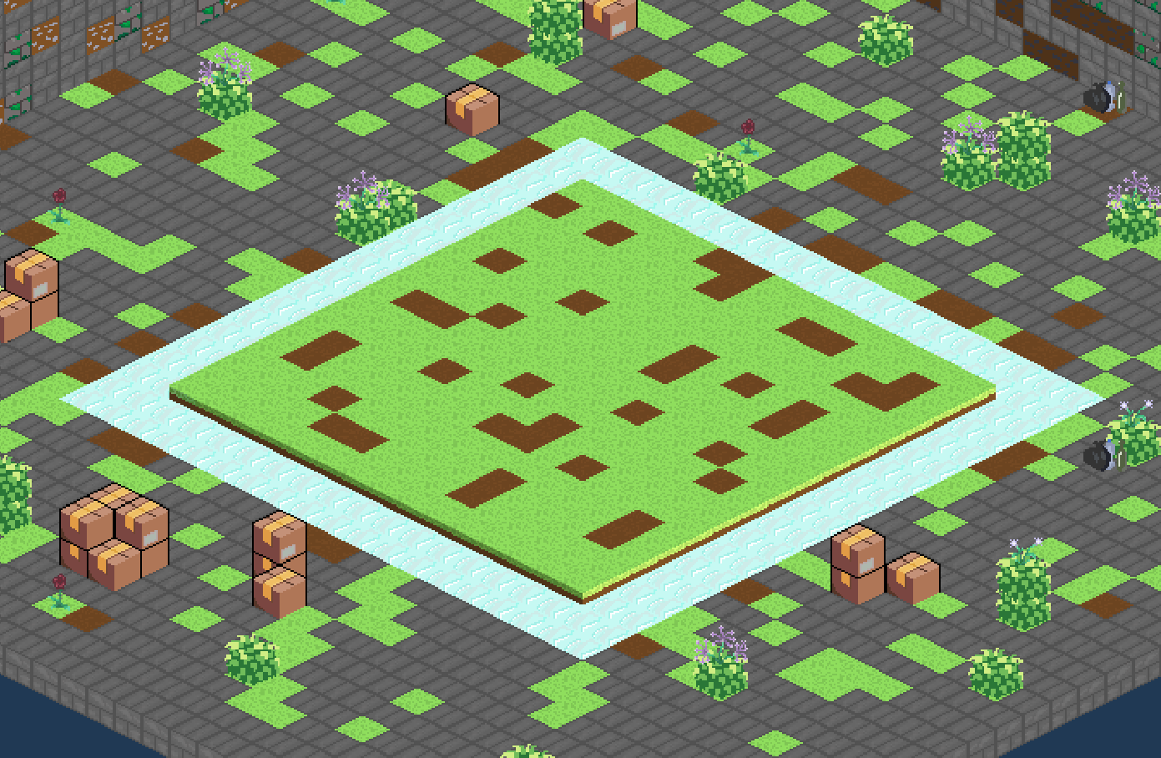
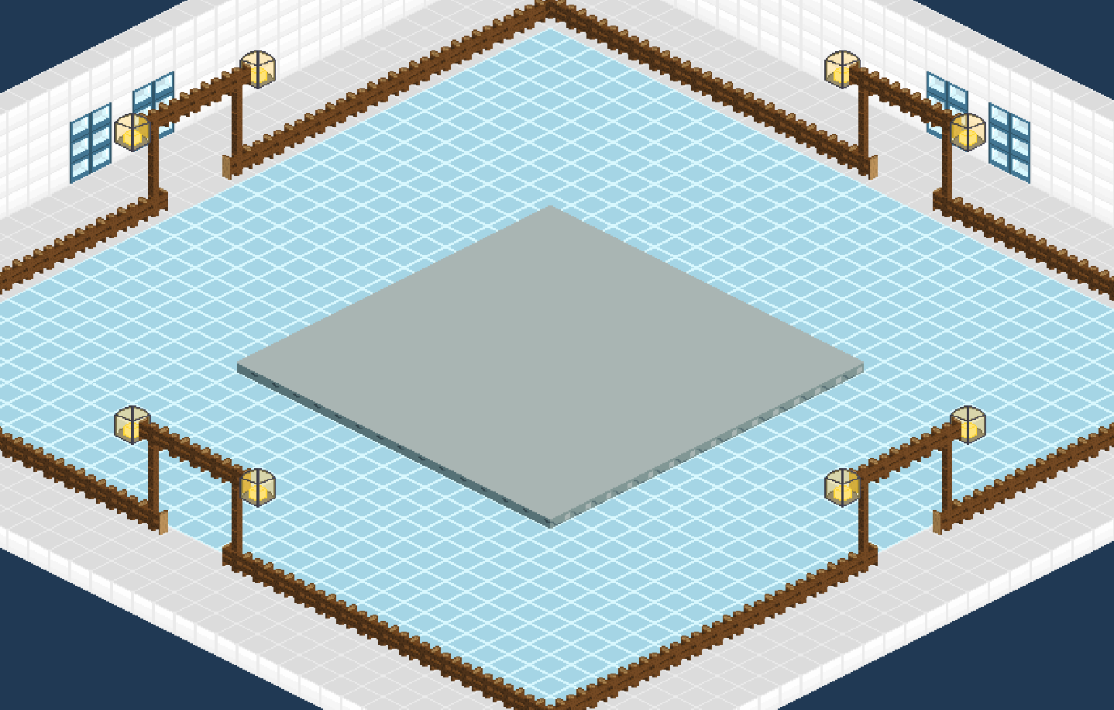
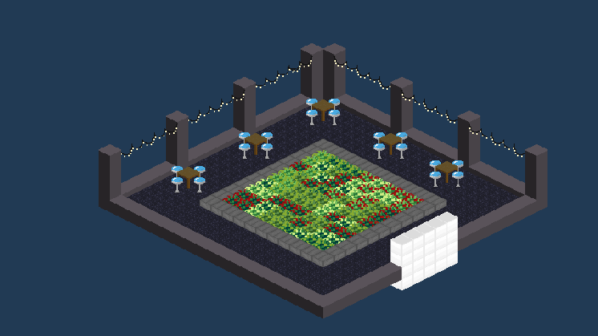

Slide 9
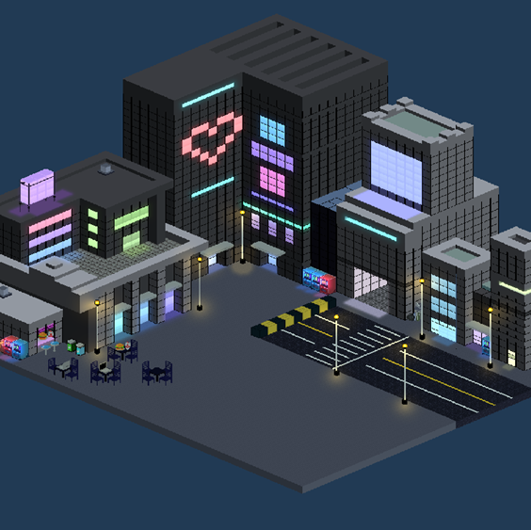
Multi-panel
Character Menu
Examine Inventory
Upgrade Attributes / Stats
Accessible from anywhere in the Neighborhood area

Slide 10
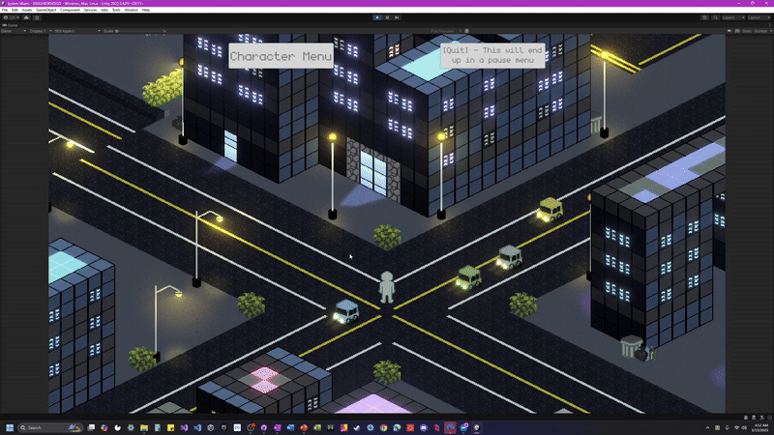
Tabbed Separation by Type
Scrolling
Inventory Items are accessed through a Tab system in the player’s Character Menu. Tabs organize items by type.
Each Tab is scrollable; if one becomes full, another row will be added to the Tab, resizing automatically.

Slide 11
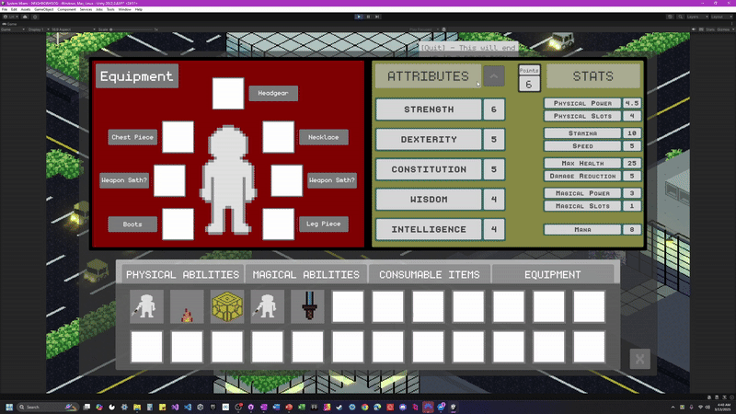
Upgrade Mode
Cancel
Button to enter upgrade mode appears when the player has Attribute Points, allowing them to increase Attributes, as well as see the effects each will have on their Stats.
Player can Cancel to leave Upgrade mode, refunding their Attribute Points and returning their Attributes to the original values.

Slide 12

Confirm
Now / Later
When ready, the player can confirm their selections, which will permanently alter their Stats.
No need to use all your Points at once. Confirm what you’re sure of and wait on the rest. The Upgrade Mode button will be accessible whenever you’ve got Attribute Points.

Slide 13
Dungeon Entry
Menu
Examine Inventory
Examine Rewards
Choose Loadout
Player proceeds or cancels Dungeon entry based on this info

Slide 14
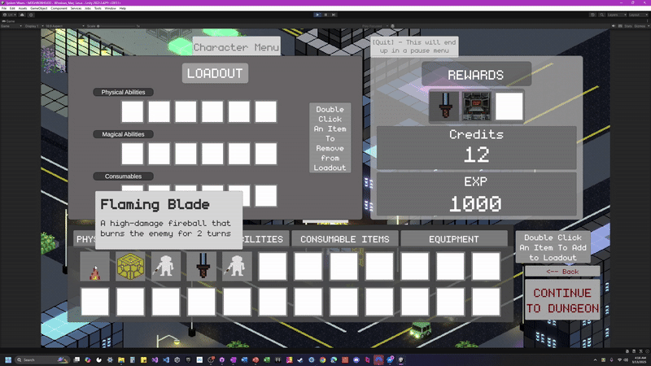
Loadout
On preparing to enter a Dungeon, the player will choose a limited number of items to bring with them into Combat.

Slide 15
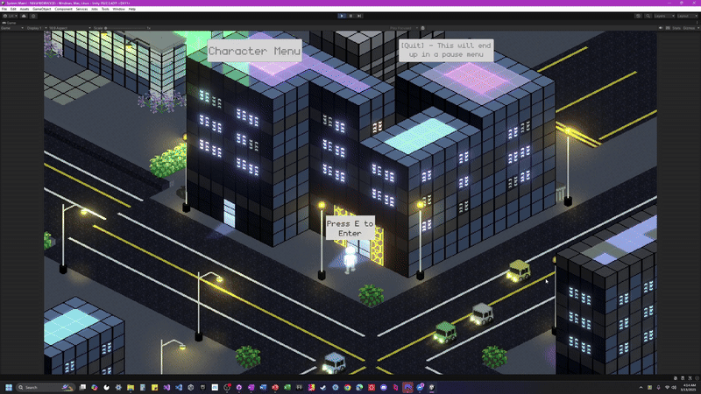
Rewards
Player will receive a random assortment of XP, Credits, and Items if they survive a Dungeon.

Slide 16
Up Next
Character Art
Player
Enemies
NPCs
UI Art
Panels
Borders
Enemies Panel
Refined Combat UI
Functional Shops
Game Board Obstacles

Slide 17
Thanks!
Questions? Feedback?

